Slide 1
Milton Friedman
經碩二 張夢芹

Slide 2
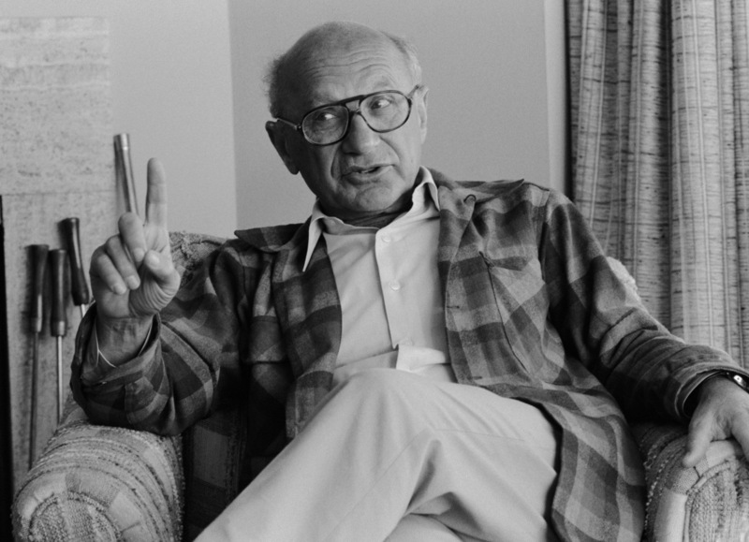
Milton Friedman Contents His Life… naive Keynesian The Optimum Quantity of Money A Program for Monetary Stability One World, One Money?

Slide 3
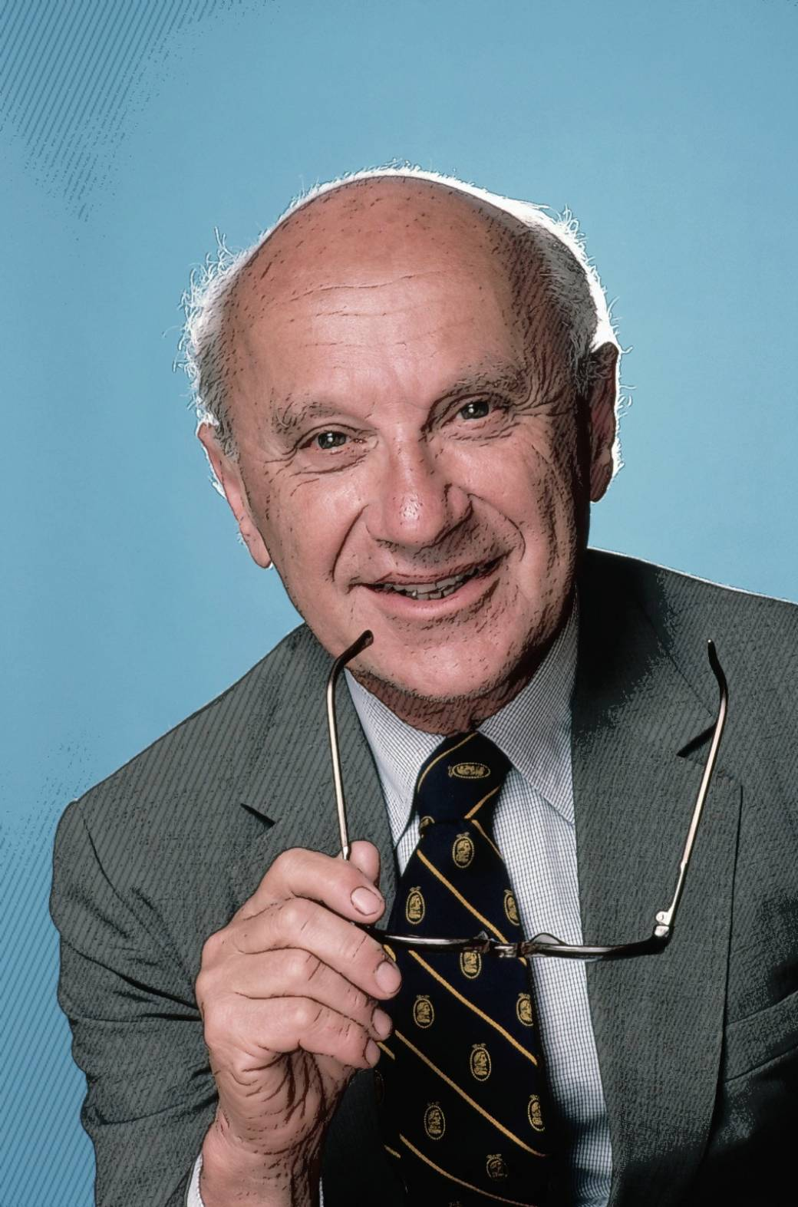
Milton Friedman His Life…
Milton Friedman received the 1976 Nobel Memorial Prize in Economic.
Friedman's challenges to what he later called "naive Keynesian" theory began with his 1950s reinterpretation of the consumption function.
Friedman argued that a steady, small expansion of the money supply was the preferred policy.
Friedman was an advisor to Ronald Reagan and Margaret Thatcher.
His political philosophy is “a free market economic system with minimal intervention”.

Slide 4
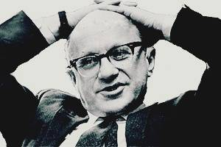
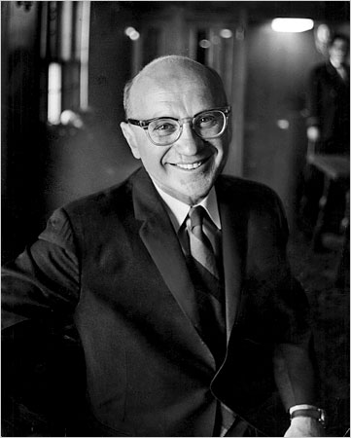
Milton Friedman His Life…
Contributions
Floating exchange rates
Helicopter money
Monetarism
Price theory
Permanent income hypothesis
Volunteer military
Natural rate of unemployment
Friedman test
(etc)

Slide 5
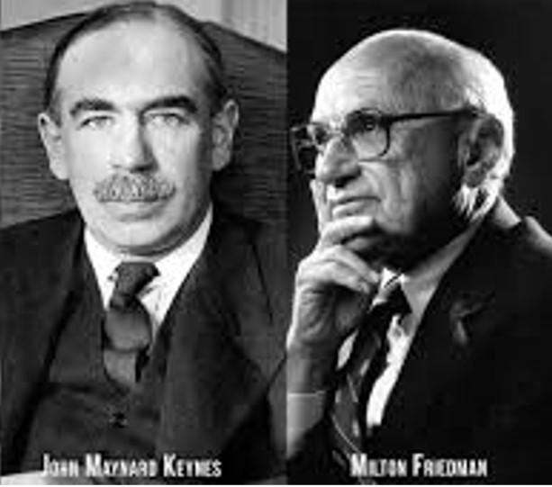

Milton Friedman naive Keynesian
Permanent income hypothesis
Lucas critique
keynesian multiplier$\frac{1}{1−MPC}$

Slide 6

Milton Friedman The Optimum Quantity of Money
IRD = - Π + MPM + MNPs
MPM + MNP = MR
MC =0
R = r + Π = MPM + MNPs
MR=MC=0
R*=0

Slide 7
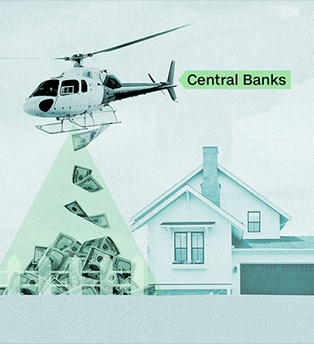
Milton Friedman The Optimum Quantity of Money
Helicopter money
Let us suppose now that one day a hel-icopter flies over this community and drops an additional $1,000 in bills from the sky…
Ben Bernanke
helicopter drop of money

Slide 8
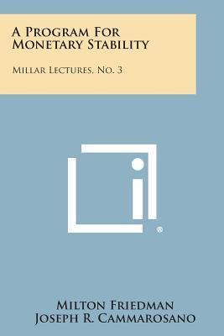
Milton Friedman A Program for Monetary Stability Summary of Recommendations
Anticipated inflations
Instruct the System to use its open market powers to producr a 4% per year rate og growth.
Fed could finance government spending by a 90-day bill or consol.
Ben Bernanke-Money-financed fiscal program

Slide 9
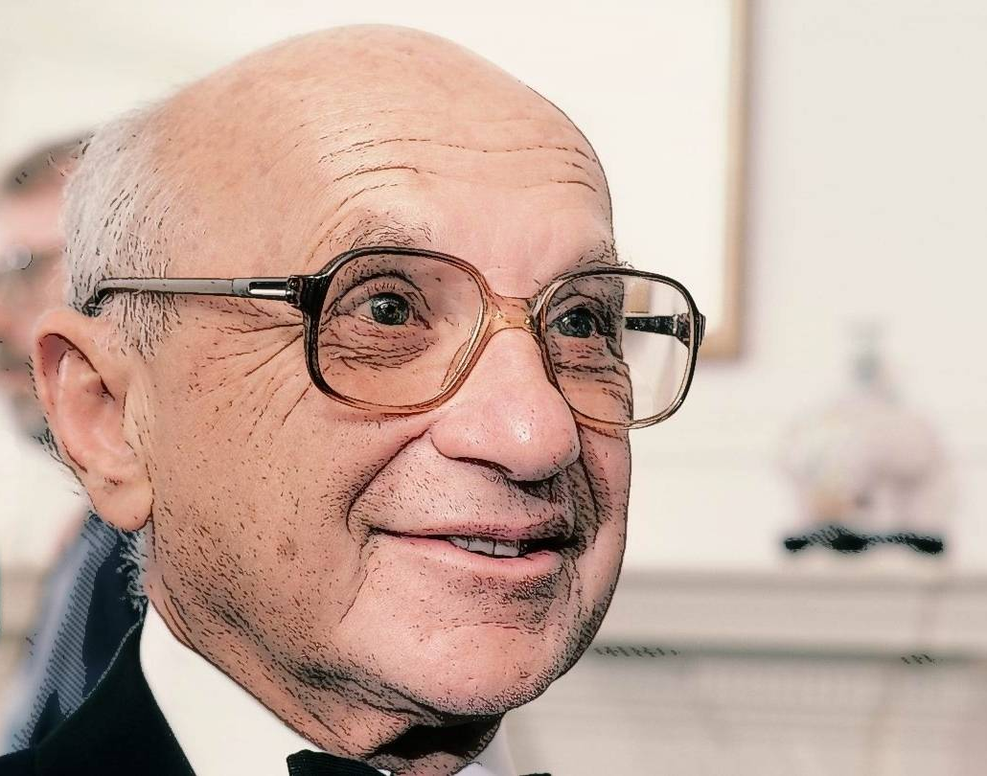
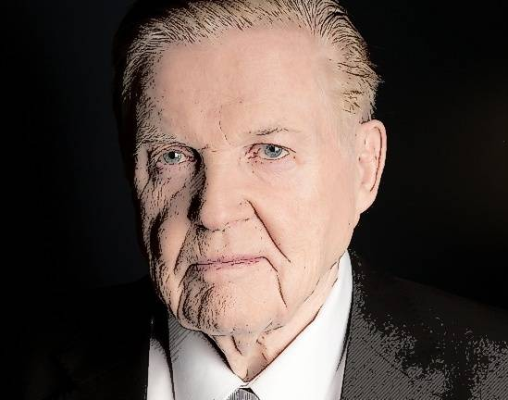
One World, One Money? Milton Friedman
Robert Mundell and Milton Friedman debate the virtues—or not—of fixed exchange rates, gold, and a world currency.
Exchange rates : Fixed or flexible?
The C-dollar : Fix or float?
The euro revolution
Has fixing hurt the Irish economy?
Why Bretton Woods Failed
The Gold Standard
A World Currency

Slide 10
One World, One Money? About Mundell Milton Friedman

Slide 11
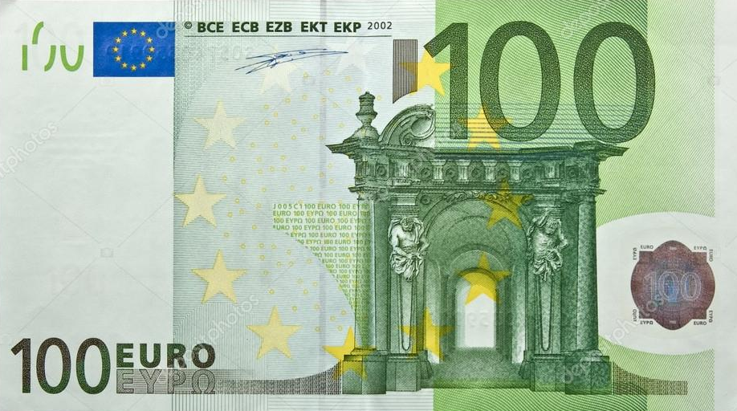
One World, One Money? The euro revolution Milton Friedman
Friedman
“Different governments will be subject to very different political pressures and these are bound to create political conflict.”
What flexible rates do is to make it possible for a country to have a good internal monetary policy, regardless of the policies followed
by other countries”

Slide 12
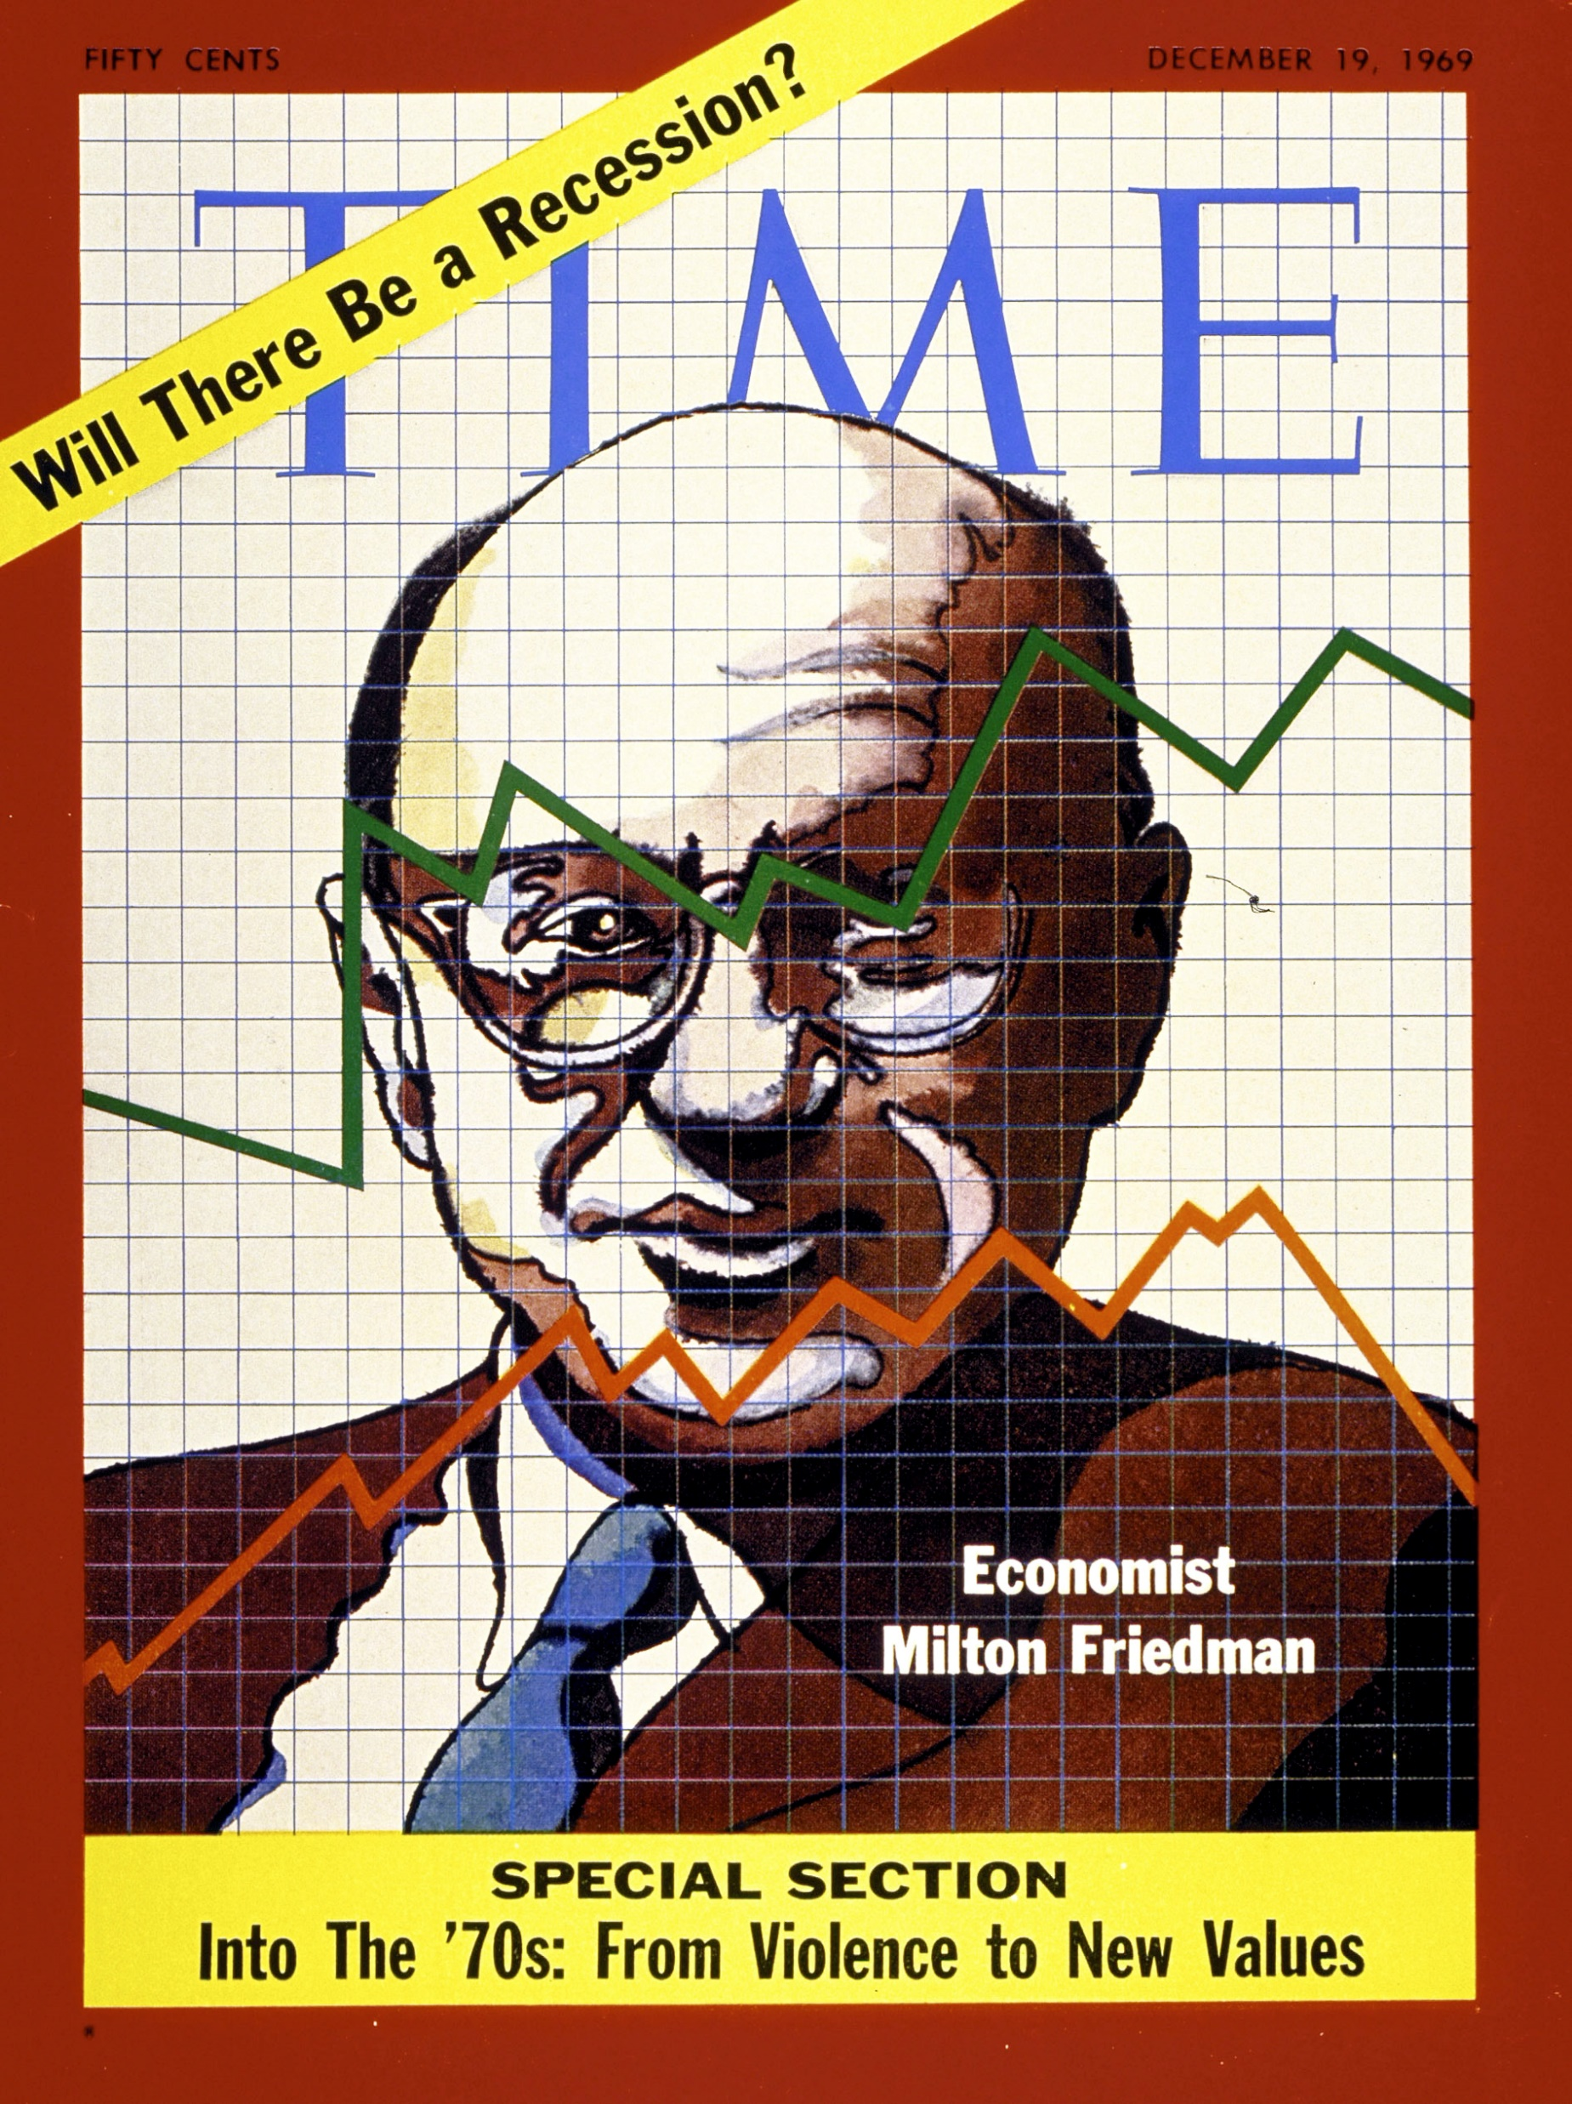
Public policy position
END

